Slide 1
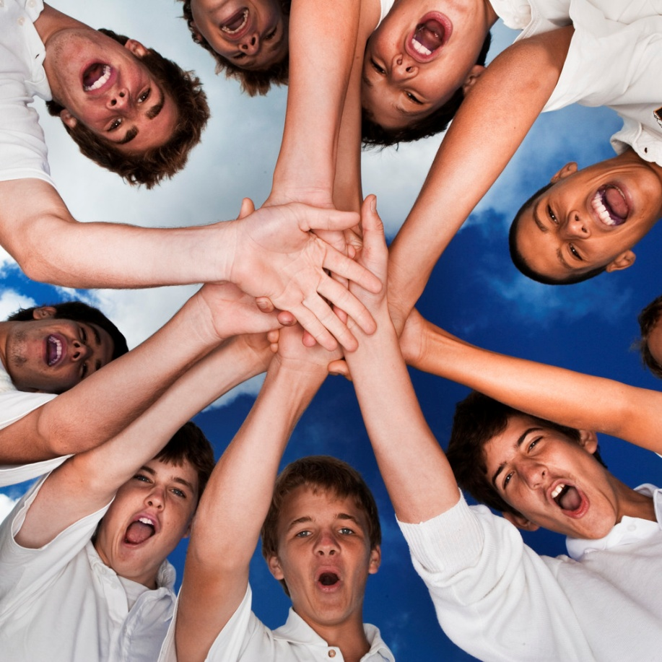
Synergize
“Alone we can do so little, together we can do so much.”
~Helen Keller
Habit 6

Slide 2
ASCA Standards
A:A2.4 Apply knowledge and learning styles to positively influence school performance.
C:A1.4 Learn how to interact and work cooperatively in teams.
PS: A2.3 Recognize, accept and appreciate individual differences.
PS: A2.4 Recognize, accept and appreciate ethnic and cultural diversity

Slide 3
6th Grade Standards
PO 1. Generate ideas through a variety of activities (e.g., prior knowledge, discussion with others, printed material or other sources).
Concept 6: Conventions addresses the mechanics of writing, including capitalization, punctuation, spelling, grammar and usage, and paragraph breaks.

Slide 4
Synergy
Synergy is achieved when two or more people work together to create a better solution than either could alone. It’s not your way or my way but a better way, a higher way.

Slide 5
Synergy IS | Synergy IS NOT
Being open-minded | Thinking you’re always right
Teamwork | Working Independently
Finding new and better ways | Compromise
Keeping Promises | Breaking Promises
Being happy that we’re different | Just tolerating differences
Brainstorming | Insisting on only one right answer

Slide 6

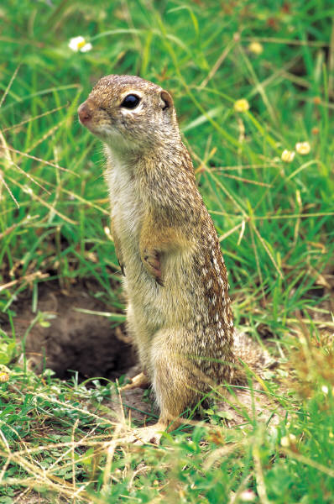
Synergy is Everywhere
In your journals give examples of synergy for each category.
Nature
School
Family
Community/Church

Slide 7
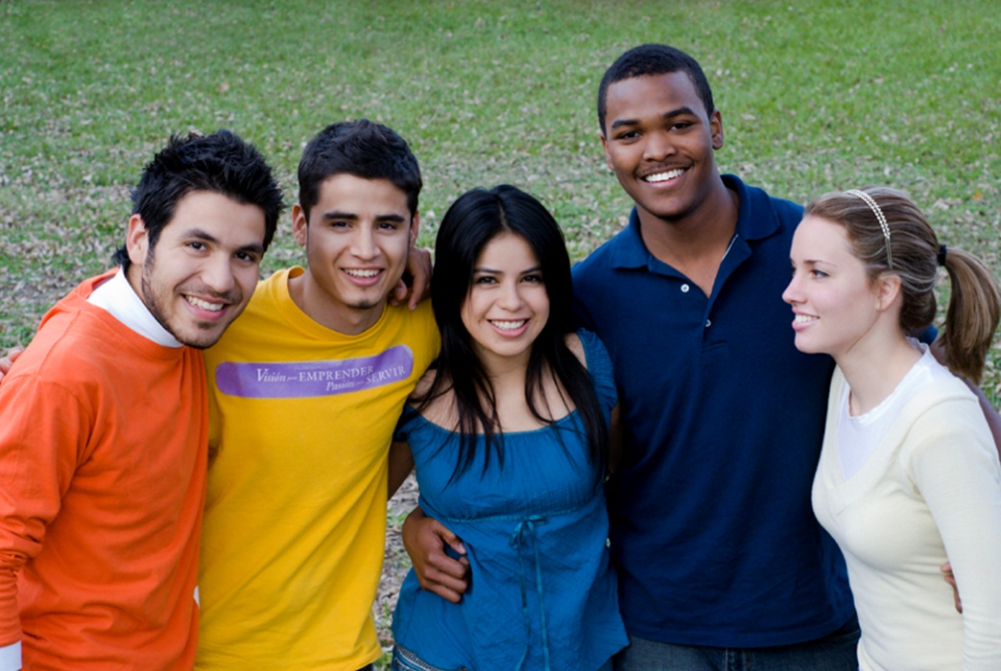
Diversity
How we are all different
  Race
  Gender
  Religion
  Age
  Dress
  Body Type
  Social Status
  Abilities/Disabilities
3 Ways to Handle Diversity
Level 1: Shun Diversity
Level 2: Tolerate Diversity
Level 3: Celebrate Diversity

Slide 8
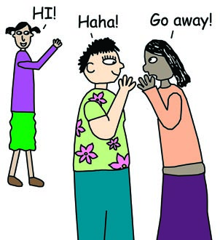
Shunners
Afraid of differences
Are disturbed by people of a different race, religion or who wear a different brand of shoes as them
Convinced their way of life is the “best” or “right” and “only” way.
Enjoy ridiculing those who are
different
Often join gangs, cliques and
other organizations that shun others.

Slide 9
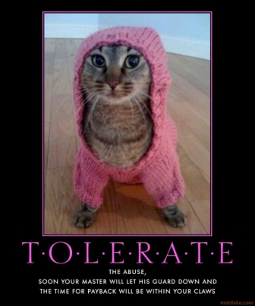
Tolerator
Believe that everyone has the right to be different
Don’t shun diversity, don’t embrace it either
“You do your thing, I’ll
do mine. You don’t bother
me, I won’t bother you.”
See differences as hurdles,
not strengths to build upon.

Slide 10
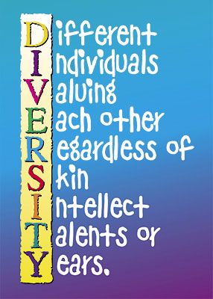
Celebrator
Value differences
Believe that two people who think differently can achieve more than two people who think alike.
Diversity=Creative Sparks=Opportunity
Celebrating differences doesn’t mean you agree with those differences, it means you value them.

Slide 11

Multiple Intelligences
“We are all as different from one another on the inside of our heads as we appear to be different from one another on the outside of our heads.”
We all LEARN differently
We are all SMART!

Slide 12
How Smart Are You?
Linguistic – learn through reading, writing and telling stories
Logical-Mathematical – learn through logic, patterns, categories, relationships
Bodily Kinesthetic – learn through bodily sensations, touching
Spatial – learn through images and pictures
Musical – learn though rhythm
Interpersonal – learn through interaction and communication with others
Intrapersonal – learn through their own feelings.

Slide 13
How Fruity Are you?
Read across each row and place a 4 in the blank that best describes you. Now place a 3 in the blank for the second word that best describes you. Do the same for the final words using a 2 and a 1.
Do this for each row.

Slide 14
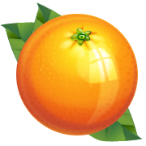

If your highest score was in column 1, consider yourself a grape
If your highest score was in column 2, consider yourself an orange.
If your highest score was in column 3, consider yourself a banana.
If your highest score was in column 4, consider yourself a melon.

Slide 15
Grapes
Natural Abilities Include:
  Being reflective
  Being sensitive
  Being flexible
  Being creative
  Preference for working in groups
Grapes may have trouble
  Giving exact answers
  Focusing on one thing at a time
  Organizing
Grapes Learn Best When They:
  Can work and share with others
  Balance work with play
  Can communicate
  Are non competitive
To expand their style Grapes need to:
  Pay more attention to details
  Not rush into things
  Be less emotional when making decisions

Slide 16
Oranges
Natural Abilities Include:
  Experimenting
  Being independent
  Being curious
  Creating different approaches
  Creating change
Oranges may have trouble
  Meeting time limits
  Following a lecture
  Having few options or choices
To expand their style Oranges need to:
  Delegate responsibility
  Be more accepting of others’ ideas
  Learn to prioritize
Oranges Learn Best When They:
  Can use trial and error
  Produce real products
  Can compete
  Are self-directed

Slide 17
Bananas
Natural Abilities Include:
  Planning
  Fact finding
  Organizing
  Following Directions
Bananas may have trouble
  Understanding feelings
  Dealing with opposition
  Answering “what if” questions
To expand their style Bananas need to:
  Express their own feelings more
  Get more explanations of others’ views
  Be less rigid
Bananas learn best when they:
  Have an orderly environment
  Have specific outcomes
  Can trust others to d their part
  Have predictable situations

Slide 18
Melons
Natural Abilities Include:
  Debating points of view
  Finding solutions
  Analyzing ideas
  Determining value or importance
Melons may have trouble
  Working in Groups
  Being criticized
  Convincing others diplomatically
To expand their style Melons need to:
  Accept imperfection
  Consider all alternatives
  Consider others’ feelings
Melons learn best when they:
  Have an orderly environment
  Have specific outcomes
  Can trust others to d their part
  Have predictable situations

Slide 19
Which fruit is best?
No one is better or worse than someone else, only different
We are all good at different things

Slide 20
Roadblocks to Celebrating Differences
Ignorance – Means you are CLUELESS! You don’t know what other people believe, how they feel or what they’ve been through.
Cliques – when your group of friends becomes so exclusive that you reject everyone who is not just like you.
Prejudice – Treating someone differently because of something about them that is different from you. (skin color, religion, body type)
Read Pg. 190 & 193
Notes:
Read Crystal’s story on page 190, read story on page 193

Slide 21
Problem Solving with Synergy
Define the Problem
Understand Their Way
  (seek first to understand the ideas of others)
My Way (Seek to be understood by sharing your ideas)
Brainstorm (Create new options and ideas)
High Way (Find the best solution)

Slide 22
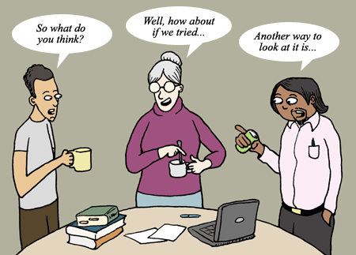
Notes:
Do Role Play – instruct students to do Getting to Synergy Worksheet

Slide 23
Getting to Synergy: Action Plan
You recently made some new friends and enjoy spending recess time with them. Your old friends are upset that you no longer hang out with them during recess.
You want to try out for the football team, you mom says its too violent and costs too much money.
You want to go to the park to see your friends after school, your dad insists that you must do your homework first. You think it’ll be dark by the time you get your homework done.
You share a room with your brother/sister. Mom says you can redecorate the room. She/he wants to paint it green and pink (black and brown) and you want to paint it (whatever your favorite color is).
Your friend recently told you that her parents have been fighting a lot and she’s worried they are going to get a divorce. Your parents have a great marriage so you don’t understand how she feels so you talk to a third friend about this to find out how to help your friend. Your first friend gets mad at you for not keeping a secret.

Slide 24
Putting the 7 Habits into Action!
When you meet a new classmate or neighbor with a disability, don’t feel sorry for them or avoid them because you don’t know what to say. Instead, go out of your way to get to know them.
The next time you are having a disagreement with a parent, try out the Getting to Synergy Action Plan
Think about someone who irritates you. What is different about them?
Brainstorm with your friends and come up with something fun, new and different to do this weekend, instead of doing the same old thing again and again.

