Slide 1
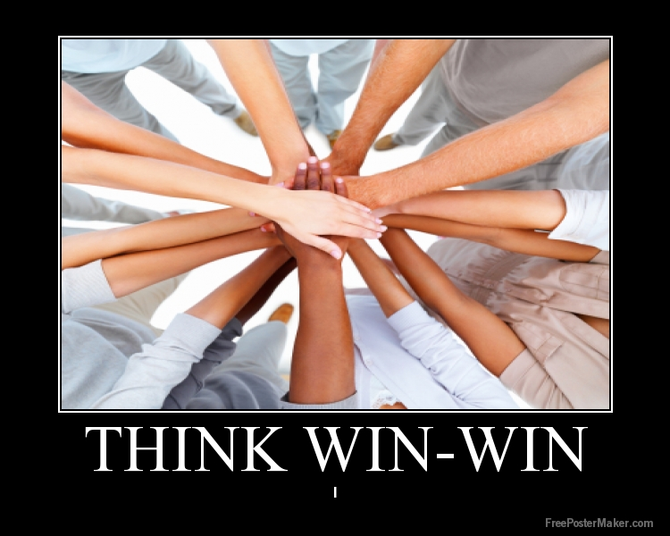
I balance the courage for getting what I want with consideration for what others want. I made deposits into others’ Emotional Bank Accounts. When conflicts arise, I look for third alternatives.

Slide 2
ASCA Standards
C:A1.4 Learn how to interact and work cooperatively in teams.
PS: B1.1 Use a decision-making and problem-solving model
PS: B1.2 Understand consequences of decisions and choices
PS: B1.3 Identify alternative solutions to a problem

Slide 3
6th Grade Standards
S1C6PO 7. Use reading strategies (e.g., drawing conclusions, determining cause and effect, making inferences, sequencing) to comprehend text.
Concept 6: Conventions addresses the mechanics of writing, including capitalization, punctuation, spelling, grammar and usage, and paragraph breaks.

Slide 4
Two friends are being chased by a bear, when one turned to the other and said, “I just realized that I don’t need to outrun the bear….
I just need to outrun you!”

Slide 5
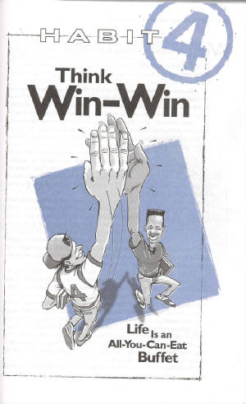
An attitude toward life that says I can win, and so can you!
We are all equal, no one is better or worse than anyone else…and no one really needs to be!

Slide 6
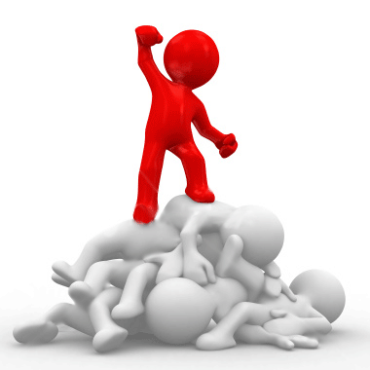
Is this picture a good one for
Think Win-Win?
Why or why not?
If not, design a better one and explain your thinking.
Notes:
Are you usually the guy on top or on the bottom?
Share story of Rodney on pg. 148

Slide 7
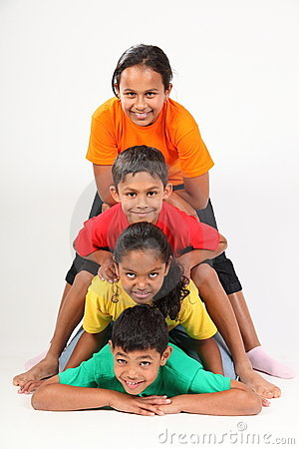
Win-Lose is like living your life on a Totem Pole
I’m better than you all!
Being the best, winning the game and having it your way mean more to you than friendships, relationships or loyalty
We’ll I’m better than her!
At least I’m better than YOU!
I’m a loser!
Notes:
Is there someone you are always in a Win-Lose relationship with?

Slide 8
Win-Lose Attitudes
Using other people, emotionally or physically, for your own selfish purposes.
Trying to get ahead at the expense of another
Spreading rumors about someone else (like putting someone else down will build you up).
Always insisting on getting your way without thinking of other people’s feelings.
Becoming jealous and envious when something good happens to your friend or family member.

Slide 9
In the end win-lose will backfire. You may end up on the top of the totem pole, but you’ll be there alone and without friends.

Slide 10
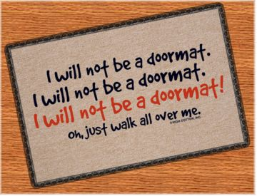
Lose-Win or the Human Doormat
Do you always let other people win?
Do you not raise your hand to answer a question because you know somebody will answer?
Do you let people jump in front of you?
Do you let people treat you poorly?
(If so, you are not practicing Think Win-Win.) Describe a time when you let people “step on you” to win.

Slide 11
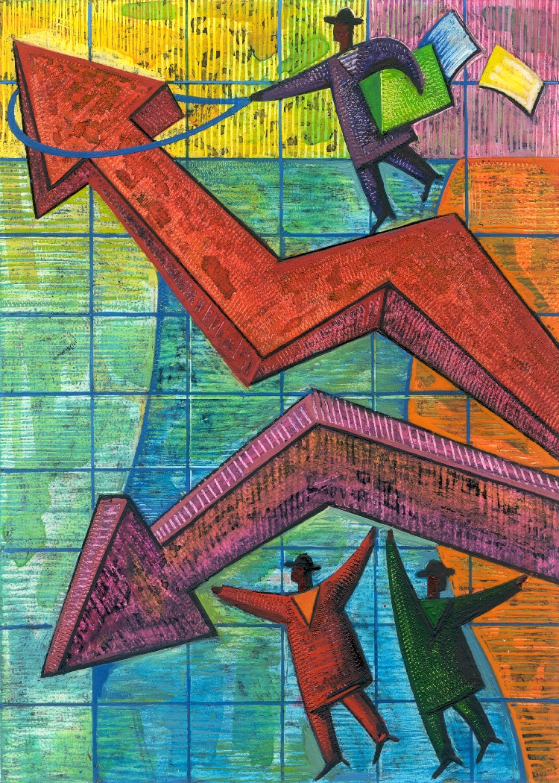
Lose-Win Attitudes
You set low expectations for yourself
You give in to peer pressure
You always let others have their way
You never voice your own opinion
You hold your true feelings inside
Notes:
Share story on pg. 150
Lose-win is okay if the issue is not that important to you (like what to watch on TV)
Be sure to take a stand on important things

Slide 12

Lose-Lose – The Downward Spiral

Slide 13
Lose-Lose Attitudes
If I’m going down, you’re going down with me. “But he was talking too.”
“Misery enjoys company”
Revenge (you may think you are winning but you are only hurting yourself)
Usually happens when two Win-Lose people get together
When you become obsessed with another person (“I don’t care what happens to me, as long as SHE fails”

Slide 14
Win-Win
Everyone can win
“I won’t step on you, but I won’t be your doormat either”
You care about others, but you also care about yourself.
Belief that there is plenty of success to go around
Notes:
Share story on pg. 152

Slide 15
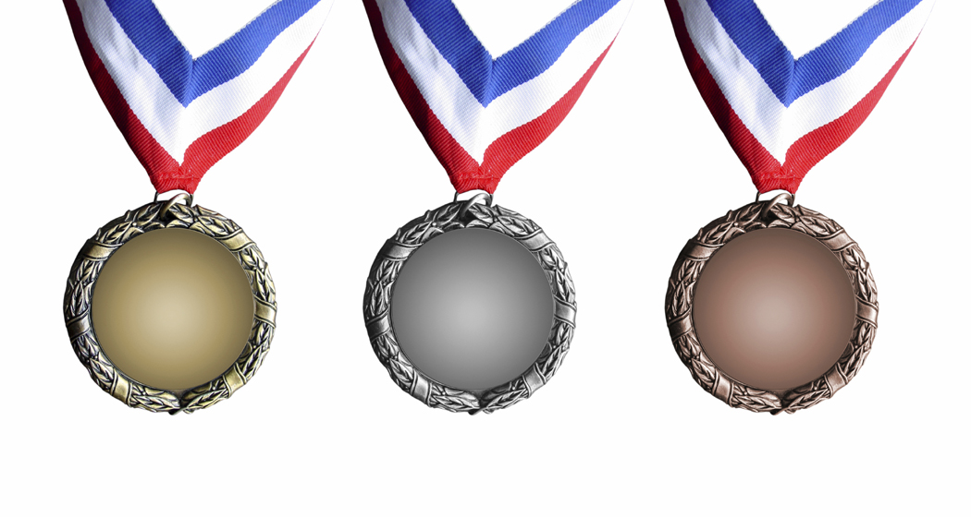
Win-Win Examples
You recently won an award at school. You share the praise and recognition with all of those who helped you get there.
You were just elected to an important school office and make up your mind not to treat others like you are better than them. You treat everyone the same, including the friendless and the unpopular.

Slide 16
Your best friend just got a part in the school play. You both tried out but you didn’t make it. Although you feel terrible about your own situation, you are very happy for your friend.
You wan to go out for dinner. Your sister wants to see a movie. You jointly decide to rent a movie and pick up food to eat at home.
You come up with another win-win situation

Slide 17

How to Think Win-Win
Win the Private Victory First
  Have self confidence
  Like who you are
  Insecure people get jealous
  very easily
  Make deposits into your
  personal bank account

Slide 18
How Else to Think Win-Win
Avoid the Tumor Twins
There are two habits, like tumors, that can slowly eat you away from the inside.
Competing
Comparing

Slide 19
Competition
Competition is healthy when you compete against yourself, or when it challenges you to reach and stretch and become your best.
Competition becomes dark when you tie your self-worth into winning or when you use it as a way to place yourself above another person.

Slide 20
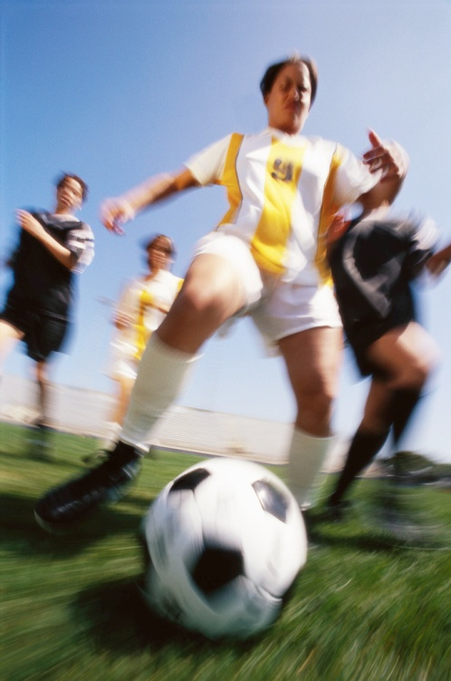
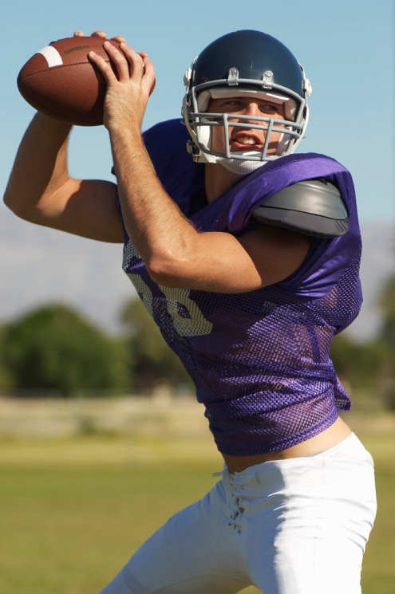
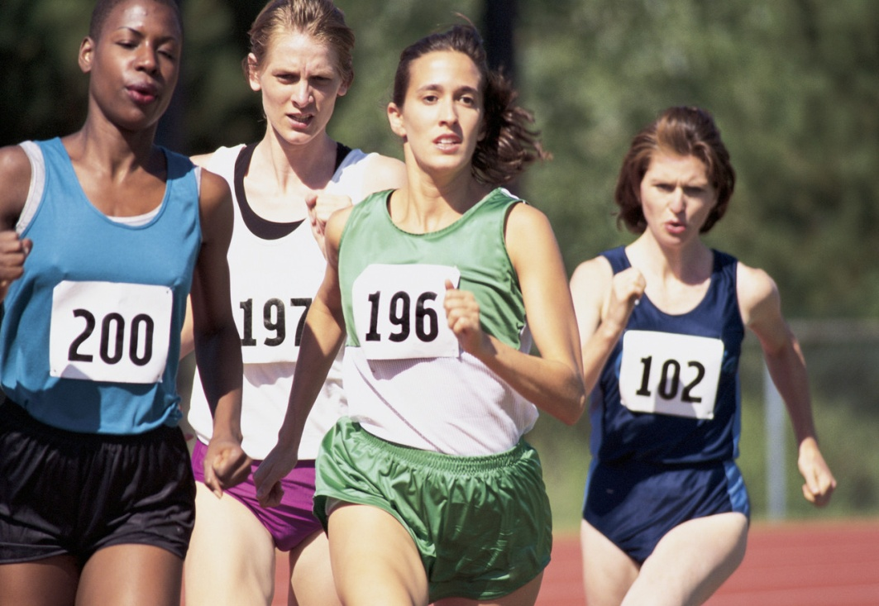
The two worst traits an athlete can have
A fear of failure
A win at any cost attitude
Why do you think this is?

Slide 21
Let’s stop competing over boyfriends, girlfriends, social status, friends, popularity, attention and the like…and start enjoying life.
There is enough popular to go around

Slide 22

Comparing to Others
Comparing ourselves makes us feel like a wave of the sea tossed to and fro by the wind. We go up and down, inferior one moment and superior the next. Confident one moment and intimidated the next.
Notes:
Read about Anne on Pg. 157

Slide 23
Resolving Conflicts with a Win-Win Solution
Do Conflict Resolution Worksheet

