Slide 1

Habit 2
Begin with the end in mind
Control your own destiny or someone else will

Slide 2
ASCA Standards
A:B2.1 Establish challenging academic goals in elementary, middle/jr. high and high school
C:A1.6 Learn how to set goals
PS:A1.1 Develop positive attitudes toward self as a unique and worthy person
PS:A1.3 Learn the goal setting process

Slide 3
6th Grade Standards
S2C3PO 1. Record information (e.g., observations, notes, lists, charts, map labels and legends) related to the topic.
Concept 6: Conventions addresses the mechanics of writing, including capitalization, punctuation, spelling, grammar and usage, and paragraph breaks.

Slide 4


Alice in Wonderland
“Would you tell me please which way I ought to walk from here?”
That depends a good deal on where you want to get to.” said the Cat.
“I don’t much care where –” said Alice.
“Then it doesn’t matter which way to walk,” said the Cat.
Notes:
Click title to watch video title. Facilitate discussion about movie clip. Stop it after the quote or watch the whole 5 min.

Slide 5
Puzzle
Have you ever put a puzzle together?
What are some things that make it easier to put a puzzle together?
  To look at the picture on the front.
  Start with the outside first.
  Other suggestions??
When we have a picture to guide us it makes it easier.
Life is the same way…when we have a clear picture of what we want to accomplish – it makes life easier.
Notes:
Select 2-4 volunteers to work on puzzle as lesson continues. Pour all the pieces to a BIG puzzle on the ground…don’t give the student(s) the box and tell them to start putting it together. Come back to them later.

Slide 6
Close your eyes
We are going to do a little daydreaming
Notes:
Read pg. 75 Paragraph 3-end of guided imagery

Slide 7
Its one year from now
What have you done with your life over the past year?
How do you feel inside?
What do you look like?
What characteristics do you possess?

Slide 8
2 reasons to begin with the end in mind
You are at a critical crossroads in your life. The paths you choose now can affect you forever.
  What are some decisions that you will make in 6th grade that can affect the rest of your life?
If you don’t decide your own future, someone else will do it for you.
  Give an example of this

Slide 9

The Crossroads of Life
The path you choose today can shape you forever
  Do you want to go to college?
  What will your attitude toward life be?
  Should you try out for that team?
  What type of friends do you want to have?
  Who will you date?
  Will you drink, smoke, do drugs?
  What values will you choose?
  What kind of relationship do you want with your family?
  What will you stand for?
  How will you contribute to your community?
Notes:
Table talk – assign one to each table and have them talk about how the decision they make today will affect their future.

Slide 10
Personal Mission statement
Its like a personal motto that states what your life is about.
You can use song lyrics, poems, quotes.
Its like advice for yourself
Something you will always try to live your life by
Examples on next slides

Slide 11
Example 1 – Mission STATEMENT
First and foremost, I will remain faithful always to my God
I will not underestimate the power of family unity.
I will not neglect a true friend, but will set aside time for myself as well
I will cross my bridges as I come to them (divide and conquer).
I will begin all challenges with optimism, rather than doubt.
I will always maintain a positive self-image and high self-esteem, knowing that all my intentions begin with self-evaluation.

Slide 12
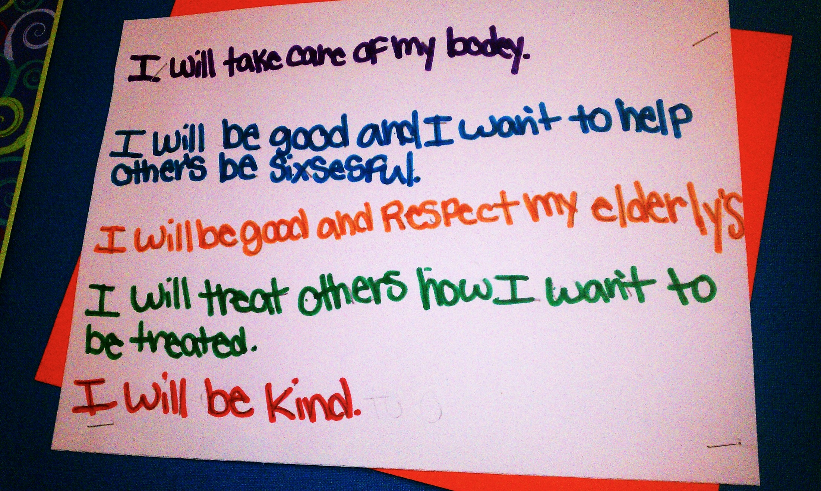
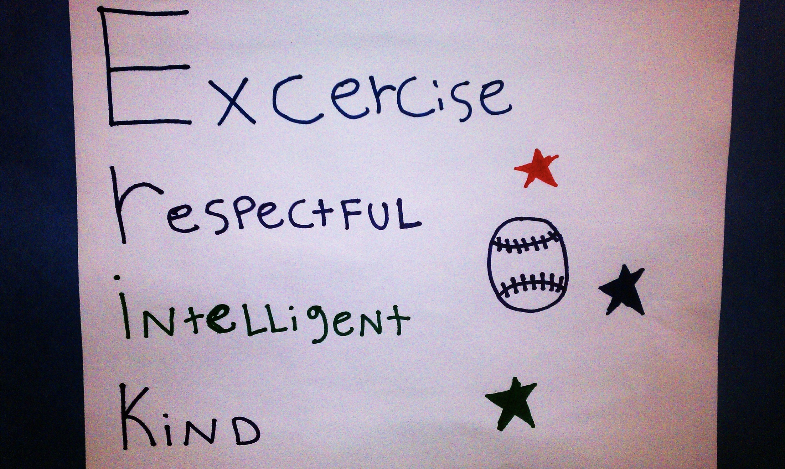
Example 3 – Mission Statement
Religion
Education
Succeeding
Productive
Exercise
Caring
Truthful

Slide 13
Example 2 – Mission statement
I will live by my own policies.
I will sleep with a clear conscience.
I will sleep in peace.

Slide 15
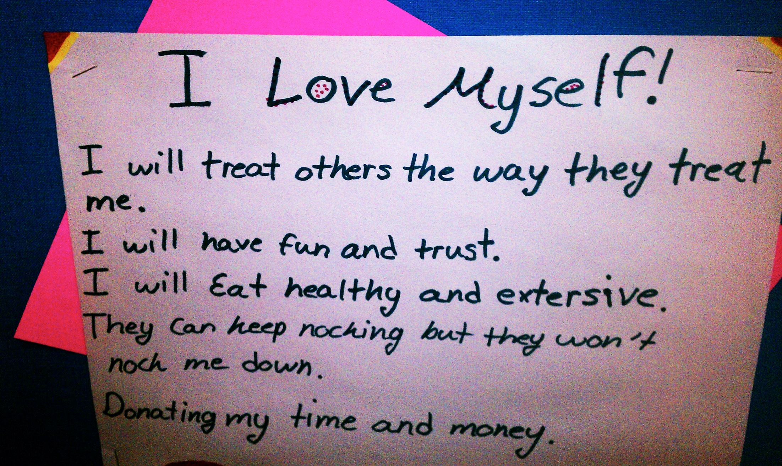

Slide 16
The great discovery
Complete the handout to learn more about yourself
Pg 74 in 7 Habits Workbook
Notes:
Pages 74-77 in 7 Habits Workbook

Slide 17
Example 4 – Be remembered
Care
  About the world
  About life
  About people
  About myself
Love
  Myself
  My family
  My world
  Knowledge
  Learning
  Life
Fight
  For my beliefs
  For my passions
  To accomplish
  To do good
  To be true to myself
  Against apathy
Rock
  The boat, don’t let the boat rock me
  Be a rock

Slide 18
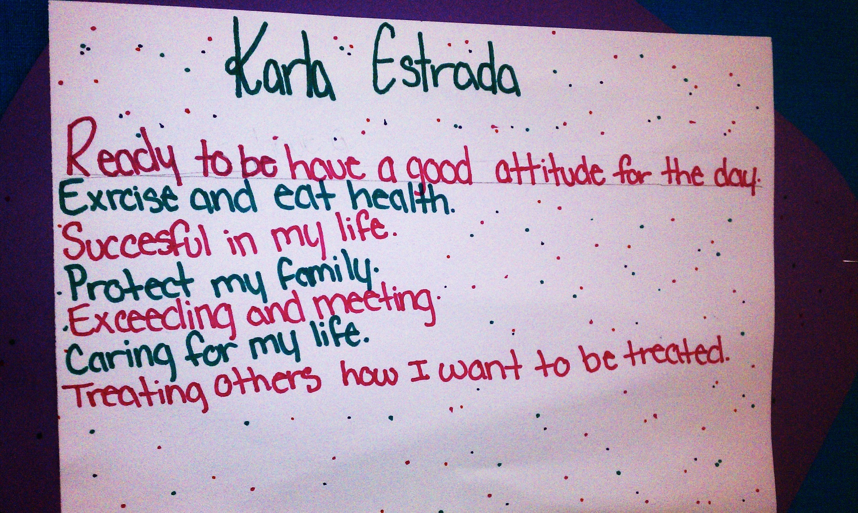

Slide 19
Create your own mission statement
In your folder. Take 10 minutes and create your own mission statement. Use these questions to guide you.
How do you want to feel about yourself?
What kind of relationships do you want with others?
How do you think you should treat others?
How do you plan to take care of yourself?
What will you do when life gets difficult?
How will you help others?

Slide 20
Mrs. Willard’s mission statement
I will always keep a positive attitude and accept myself for who I am.
I will treat others with kindness and respect.
I will always put my family first.
I will eat healthy and exercise to stay in good health.
When life gets tough, I will roll with the punches and know that all things happen for a reason.
I will do my best to help those less fortunate than me.

Slide 21
Goals in action
Listen to the story of David, a 95 pound high school freshman who had a goal!
What do you notice about David’s Goal?
Was his goal specific?
Was his goal measurable?
Was his goal attainable?
Was his relevant?
Did he have a time frame on his goal?
Notes:
Read story on pages 99-100

Slide 22

Successful middle schoolers have goals that help them…
Know where they are going and what positive actions they need to take to get there
Develop a sense of accomplishment
Know where they need to put additional effort
Clarify their wants, needs and desires
Set their priorities

Slide 23

Identifying goals
Unifies your efforts and energy
Gives meaning and purpose to all that you do
Translates itself into daily activities so that you are:
  Proactive
  In charge of your life
  Making happen each day the things that will enable you to fulfill your goals.

Slide 24
SMART Goals
Specific
Example: My goal is to save $200 to buy an IPOD for my dad by December 25 because I lost his first one.
(please write your specific goal in the space provided)
Who? What? When? Where? Why?
Measureable
Example: I will save $20 a week for 10 weeks.
(How will you monitor your goal? Ask: How often? How many? How much?
Attainable
Example: I will do extra chores and babysit to save the money.
(What are the steps you need to take to reach this goal?)
Realistic
Example: Yes, I have earned money before and know how to save it.
Is this a goal that you can achieve? How do you know?
Timely
Example: I want to reach my goal by December 24, 2011
(When do you want to reach your goal?)

Slide 25

Creating your own smart goals
Use the worksheet provide to write a SMART goal for you based on your Boys Town Skills.
Next week we will use the same paper to write a SMART Academic Goal.

