Slide 1
The 7 Habits of Highly Effective Teens
Habit 1: Be Proactive

Slide 2
ASCA Standards
PS:A1.8 Understand the need for self-control and how to practice it.
PS:A2.2 Respect alternative points of view
PS: B1.3 Identify alternative solutions to problems.

Slide 3
6th Grade Standards
S1C1PO 1. Generate ideas through a variety of activities (e.g., prior knowledge, discussion with others, printed material or other sources).
Concept 6: Conventions addresses the mechanics of writing, including capitalization, punctuation, spelling, grammar and usage, and paragraph breaks.

Slide 4
There are 2 types of people in the world. Which one are you?
Reactive (the blame game)
Proactive (I am in control)
If someone calls you a name, you call them one back.
If someone hits you, you hit them back.
If you get a bad grade, you blame your teacher.
If you lose a game, you blame the other team.
You think before you act.
You recognize you CAN’T control everything that happens to you, but you can control what you do about it.
You don’t let others push your buttons or allow you to become angry or upset.

Slide 5
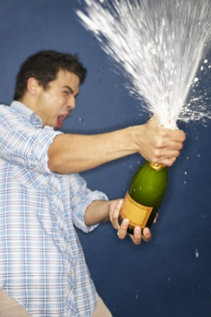
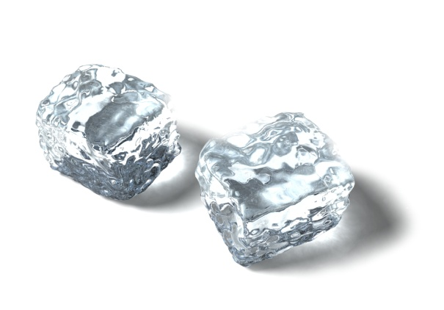
Which one describes you?
Reactive (the blame game)
Proactive (I am in control)
Reactive people make choices based on impulse. They are like a can of soda. If life shakes them up a bit, the pressure builds and they suddenly explode!
Proactive people are like a bottle of water. You can shake them up all you want, take off the lid, and nothing will happen. No fizzing, no bubbling, no pressure. They are calm, cool, and in control. (Soda/Water Video)

Slide 6
Let’s practice
We will read each situation and then make a list of reactive and proactive responses.
We will make a tree map and classify the responses.
Notes:
Liz – where do t

Slide 7
Scenario 1
You overheard your friend talking about you to a group of 7th graders. She does not know that you overheard the conversation. Just 5 minutes ago the same friend was being extra nice to you. You feel hurt and betrayed.
Let’s classify some reactive and proactive responses together.

Slide 8
Scenario 1
Reactive
Proactive
Tell her off
Fall into a deep depression because you feel so bad about what she said.
Give her the silent treatment for being two faced.
Spread rumors about her as payback!
Forgive her
Confront her and CALMLY explain how you feel.
Ignore it and give her a second chance.
Realize that sometimes you talk behind her back and you really don’t mean any harm.

Slide 9
Scenario 2
You just found out that your little sister got new shoes and your mom promised you new shoes over a month ago.
Make a list of reactive and proactive responses.
Share out

Slide 10
Scenario 3
Before school you were playing basketball with your friends. The other team cheated and ended up winning the game just as the bell rang to line up.
Make a list of reactive and proactive responses.
Share out

Slide 11
Scenario 4
Mrs. Epley is having a pizza party for her students who have been using the skill of getting the teacher’s attention appropriately this week. When she read the list of the kids who earned it, your name was not on it. You know you used the skill all week.
Make a list of reactive and proactive responses.
Share out

Slide 12
Changing your language
Reactive Language
Proactive Language
I’ll try
That’s the way I am
There’s nothing I can do
I have to
I can’t
You ruined my day
I’ll do it
I can do better than that
Let’s look at all our options
I choose to
There’s got to be a way
I’m not going to let your bad mood rub off on me

Slide 13
It pays to be proactive because…
Proactive people:
Are not easily offended
Take responsibility for their choices
Think before they act
Bounce back when something bad happens
Always find a way to make it happen
Focus on things they can do something about and don’t worry about things they can’t
Notes:
Read story on bottom of page 53

Slide 14
Which of these things can we control?
The color of our skin?
Weather?
Parents?
Rude Comments from classmates?
Who will win the Super Bowl?
How we respond to what happens to us?

Slide 15
What does this quote mean?
“It’s not what happens to you in life, it’s what you do about it.”
Think-Pair-Share

Slide 16
Turning Setbacks into Triumphs
Life often deals us a bad hand and it’s up to us to control how we respond.
Every setback is an opportunity for us to turn it into a triumph.
Read Five Short Chapters on page 62
No Arms No Legs No Worries Video
Notes:
If time, read stories on page 57

Slide 17
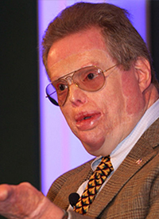
W. Mitchell
Pg. 57 in 7 Habits Book

Slide 18
What is your attitude?
Can do
No-can do
Make things happen
Think about solutions and options
Act
Wait for something to happen
Think about the problems and barriers
Are acted upon

Slide 19
Learn to push pause
So when someone is rude to you, where do you get the power to resist being rude back?
PUSH PAUSE
Sometimes things happen so fast that we instantly react out of habit.
Learn to pause and gain control
Think about how you will respond
You will make better decisions

Slide 20
4 Tools That Will Help You
Self-Awareness: I can stand apart form myself and observe my thoughts and actions.
Conscience: I can listen to my inner voice to know right from wrong.
Imagination: I can envision new possibilities.
Willpower: I have the power to choose.

Slide 21
Reflection Time
Think back to the past week. Have you been reacting in a proactive or reactive way?
If you have been reactive, what are some steps you can take to be proactive?
What can you do to prevent others from allowing you to explode?
Reflection Song Link
Notes:
Click the link for a song

